Slide 1
Course Introduction Data Analysis for Psychology in R 1
DAPR1 Team
Department of Psychology
The University of Edinburgh

Slide 2
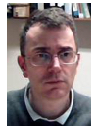



The DAPR1 Team
Course organisers
Dr Patrick Sturt
Dr Umberto Noe
Instructors
Dr Patrick Sturt (in Block 1)
Dr Monica Truelove-Hill (in Block 2)
Dr Umberto Noe (in Block 3)
Dr Emma Waterston (in Block 4)
Tutors
Many knowledgeable and approachable tutors
Course administrator
Georgiana Gherasim
ppls.psych@ed.ac.uk

Slide 3
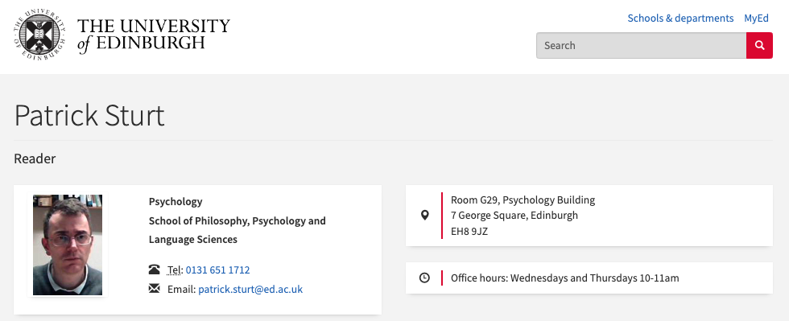
Office hours
Course LEARN page > Course information > Course contacts >
Click on the instructor’s name
Office Location
Email
Office Hours information

Slide 4

DAPR1 and your degree
In DAPR1, we will teach you how to
Deal with data in R
Tidy, manipulate, and transform data
Visualise data
Using data to answer basic research questions.

Slide 5
Course aims
Build the core data and R skills at a slow and steady pace.
Introduce key statistical concepts.
Help you develop an effective approach to studying data analysis.
Encourage you as a cohort to be collaborative, supportive peers.
Integrate with Psychology 1A and 1B.

Slide 6
What is the R in DAPR1?
R is the name of a very flexible and free programming language for working with data
It does pretty much any statistical analysis you can think of
But it does a lot more…

Slide 7
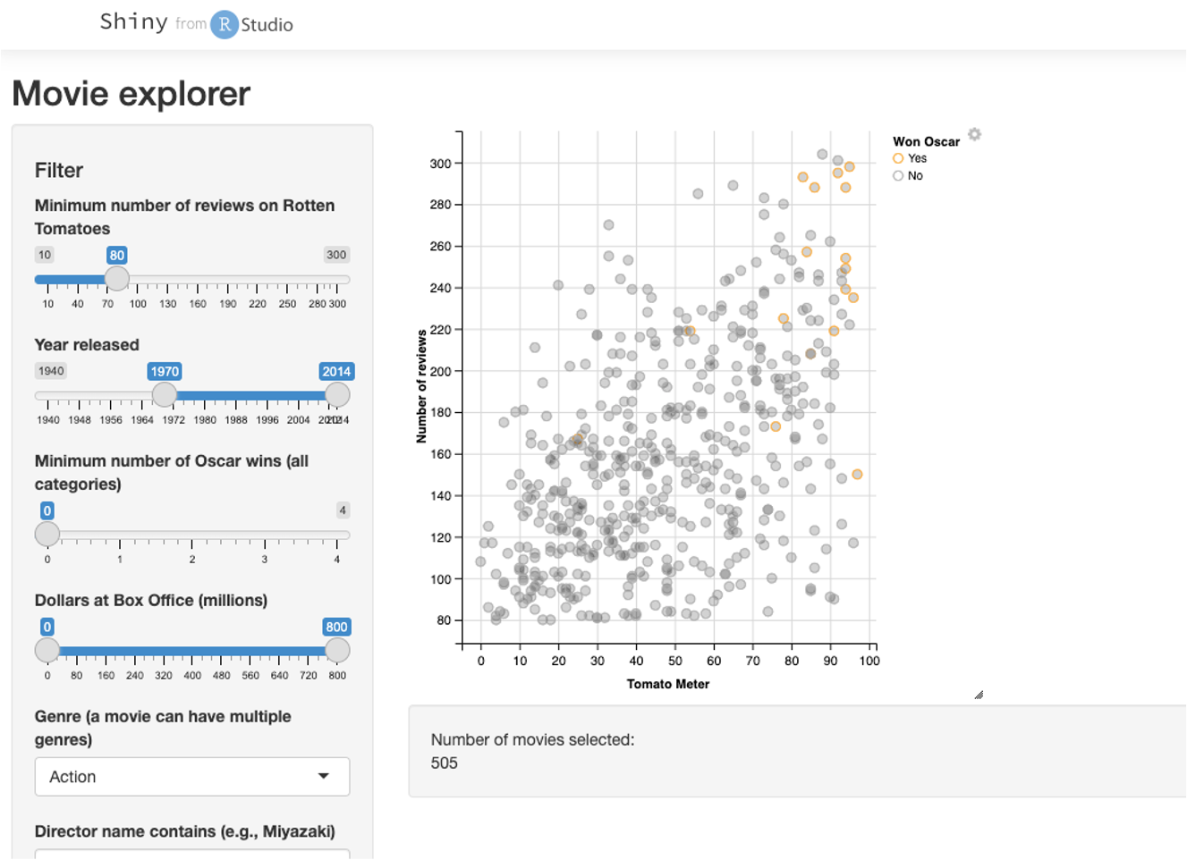
Interactive plots
For example: https://shiny.rstudio.com/gallery/movie-explorer.html

Slide 8
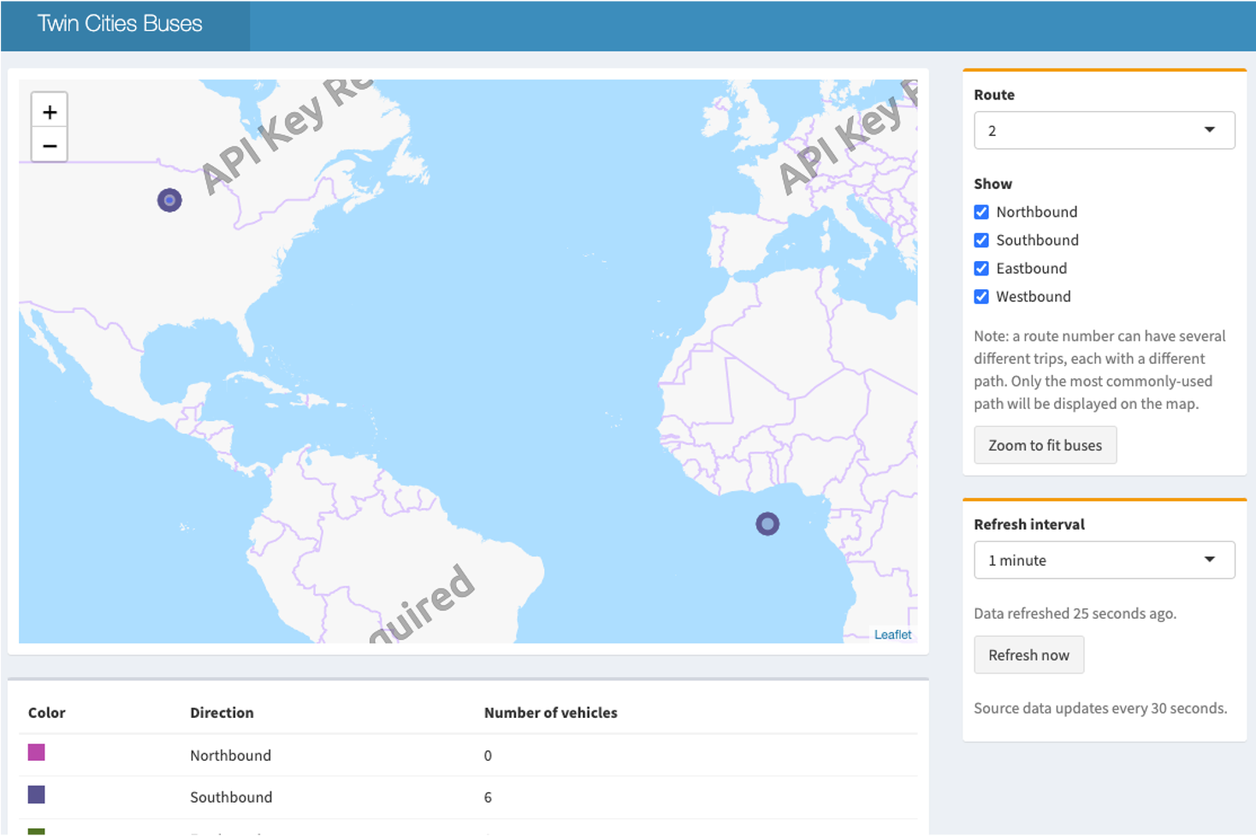
Interactive dashboards
For example: https://gallery.shinyapps.io/086-bus-dashboard/

Slide 9
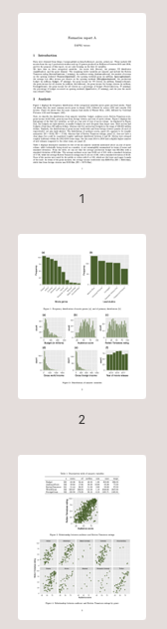
Reports
Documents which automatically include results from analysis
We will create these in the labs

Slide 10

Books
For example: https://r4ds.hadley.nz/

Slide 11

Websites
For example: https://rmarkdown.rstudio.com/

Slide 12
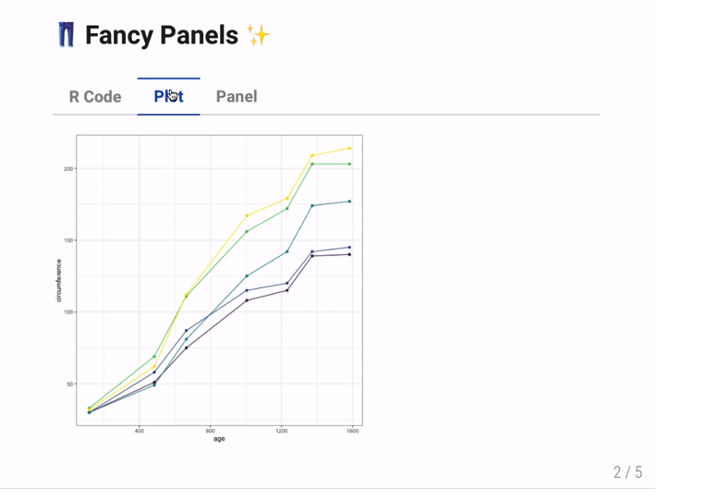
Presentations

Slide 13
Course overview
The course involves a mixture of conceptual and practical programming lectures.
Each week, the first lecture will be more “conceptual” while the second more “practical”.
Each week, go to your allocated lab session, where you will gain experience in applying those concepts

Slide 14
Expectations
Attendance (unless unwell)
Engagement
Respectful interactions

Slide 15
Expectations
The course is delivered in person, and each week you are expected to attend both lectures and labs.
Two lectures each week
The first is on Mondays, while the second is on Tuesdays.
Lecture activities or readings
Each week you may be assigned activities or readings, and you are expected to complete those.
Labs with tutors
Group-based practical sessions
Goal is preparing you to analyse real data and write up reports
They involve a set of structured tasks to be solved with the help of R
1 hr per week
Will require you to produce and submit formative assessments as a group, in preparation for the assessed report

Slide 16
Course contents
Year-long course which comprises four blocks of five weeks each:
DAPR1
Block 1: Exploratory data analysis (Sem 1, Weeks 1-5)
Block 2: Probability (Sem 1, Weeks 7-11)
Block 3: Inference (Sem 2 Weeks 1-5)
Block 4: Common hypothesis tests (Sem 2 Weeks 6-10)
Will focus on data collection and exploratory data analysis.
Will introduce probability theory and distributions, with particular attention to the normal probability distribution, which arises in many everyday situations. We will then build on those concepts to introduce sampling distributions, which show the variability of quantities like the mean from sample to sample.
Introduces the step-by-step process of testing a research hypothesis and focuses on explaining in depth the meaning of each component of a test of hypothesis.
Teaches widely used hypothesis testing procedures that are used in everyday research to answer questions about a population.
Labs: Formative report A
Labs: Formative report B
Labs: Formative report C
Assessed report

Slide 17
Help and support
Labs (see your personal timetable for the time)
Ask tutors for help on R, lab materials, concepts from the lectures
Piazza Discussion forum (see LEARN for link)
Write your questions to get answers from your peers and/or instructors
Advantage: you will also help peers with the same question!
Office hours (see LEARN for details)
1:1 support sessions with an instructor
LEARN > Course information > Course contacts > Click on the instructor’s name for details
Student adviser
Your student adviser (you can find their name on Euclid) can support you on anything that is not directly related to the course materials or can refer you to the other support services available.

Slide 18
Important
The course requires you to work steadily and consistently across the year.
Each week’s content builds on the previous weeks, so it is cumulative.
It requires regular studying and keeping up to date. It is not designed for leaving everything to last minute all-night studying before assessments.
To help you build study skills, the course has a specific assessment structure which integrates multiple formative assessments.
This creates an iterative improvement path.

Slide 19
Assessments
The DAPR1 final grade is made up of the following components:
Weekly quizzes (10% of final grade)
Assessed report (30% of final grade)
Final exam (60% of final grade)

Slide 20
Assessments: Weekly quizzes
Weekly quizzes (10% of final grade)
There are 14 assessed quizzes, but only the 10 best scores out of the 14 quizzes will count towards the final grade.
Released on a Monday at 9am and due on the Sunday at 5pm.
The feedback and solutions will only be available after the deadline (after Sunday at 5pm)
No extensions, as these count as continuous summative assessments.
There are also 2 practice quizzes at the start of the course which won’t count towards your grade

Slide 21
Assessments: Assessed report
Assessed report (30% of final grade)
No extensions, as this is groupwork-based
To be done during weeks 6-10 of semester 2
Format: each group will be given data and a set of tasks, and you will be required to write up your analysis
Multiple opportunities to practice during the labs, by creating 3 formative (practice) reports
In the previous years, students who attended most/all labs and submitted all formative reports were more likely to score higher on the assessed report.

Slide 22
Assessments: Final exam
Final exam (60% of final grade)
After semester 2 in the Main Exam Diet (April/May)
60 multiple choice questions
Written in an exam hall

Slide 23
Course materials
Each week's material will be within a weekly folder on LEARN containing:
Weekly quiz
Lecture slides
Lecture activities or readings
Lab exercises
The weekly folders will become available incrementally on LEARN.

Slide 24
What you can expect from us
We will work hard to help you learn.
We will be open and communicate with you.
We will be polite, respectful and treat you like adults.

Slide 25
What we expect of you
You work regularly throughout the year and keep up to date with the materials.
You interact and communicate with the teaching team.
You are polite and respect the teaching team and your classmates.
If you email, include the course name DAPR1 in the subject as some instructors also teach in DAPR2 or DAPR3.

Slide 26
A brief word on engagement
We are very keen to make sure everyone succeeds
To do that, we need to know when people are struggling
Please, let the tutors or instructors know if you are struggling, so that we can help
We will keep an eye on this in a few ways:
Attendance during office hours
Engagement (discussion forum, labs)
Weekly quiz performance

Slide 27
Lab pedagogy
Based on novel educational practice and informed by student feedback
Pair programming principles (driver vs navigators)
Group work
Assessment for learning with formative feedback
Modern and inclusive lab materials that respect diverse learning communities
Multiple layers of support
Peer-to-peer
Hints
Worked Example
Tutor Explanation
Office Hours
Extra examples on R code
Color contrast accessibility also available
Notes:
Pedagogy: paired programming, shown to be beneficial to learn coding for people with no prior experience of programming.

Slide 28
Lab structure
The course has 3 labs each week, and you have been allocated to one lab per week. See your personal timetable for which one to attend.
Within each lab, you will work in groups (one group per table) of at most 5 students.
In each group:
One person is the “driver” – responsible for typing on the PC for that week
The rest are the “navigators” – responsible for commenting on the strategy, spotting and fixing typos or coding errors
The driver will rotate each week.

Slide 29
Lab structure
Group-based work in preparation of the assessed report in Sem. 2
As a group, you will create 3 formative reports (two in Sem. 1, one in Sem. 2) for which you will receive feedback
One group per table, each group has a name
Take note of the group name
For example, Lab 1 has Group 1.A, 1.B, 1.C, 1.D, …
During your first lab you must self-register for the group with that name on LEARN.
Notes:
https://uoepsy.github.io/dapr1/2324/labs/1_01_design_and_data.html

Slide 30
Own-work Policy
The use of generative AI tools is not permitted for any assessment of this course.
For group-based reports:
Avoid plagiarism on reports
Don’t copy/share work between groups
Don’t copy verbatim from the lab materials
Own-work policy:
Weekly quizzes
Final exam
Failure to comply with the instructions above is in direct violation of the university own-work policy and will be reported to the academic misconduct office

Slide 31
Tasks for welcome week
Go to the course LEARN page > click Course Materials: Semester 1 > click S1 Week 0: DAPR1 Starts Here! and complete the Tasks:
Watch the Course introduction video (this one)
Read the Course Information folder
Read the Assessment > Assessment information page
Register for the RStudio server online
Watch the RStudio Server overview video

Slide 32
Welcome to the course!

